Slide 1
Animal Behaviour Prediction
Milestone 2 & 3

Slide 2
Introduction
Accelerometer data can provide valuable insights into how animals behave, offering applications in various fields.
Today, we will see how to test the hypothesis: "Accelerometer data affects animal behavior."

Slide 3
Accelerometer data is the measurement of acceleration along various axes (X, Y, Z) and is used extensively in human and animal monitoring.
Understanding animal behavior is crucial for wildlife conservation, agriculture, pet care, and more.
Accelerometer data has the potential to revolutionize the study of animal behavior.

Slide 4
Hypothesis
Based on the scatter plotting between time and average of accelerometer data. It observed that there is significant high value in activity along Y axis
To confirm that, doing a hypothesis test
.
Hypothesis: There is a significant difference in 'y' axis activity between daytime and nighttime.
This hypothesis is significant because it explores the potential relationship between hours and its activity
We aim to determine whether accelerometer data can provide valuable insights into animal behavior.

Slide 5
Performed the hypothesis using ztest, finally it concluded There is a significant difference in 'y' axis activity between daytime and nighttime.
Notes:
For hypothesis test, ihave created a column hour which is derived from the timestamp column

Slide 6
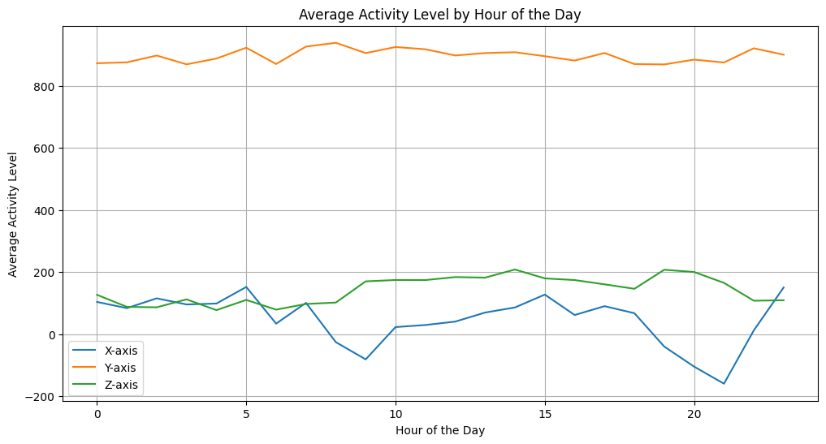

Slide 7
Feature Extraction
Features has been derived from the existing data
Hour: derived the hour from timestamp
Rms: root mean square calculated from x, y and z
rms=sqrt((x**2+y**2+z**2)/3)
Absolute rms
Cluster: this column is created after performing KMeans algorithm to the data taken x,y, z and hour features.
4 clusters has been formed as follows:
0: eating
1: standing
2: remuneration
3: others

Slide 8
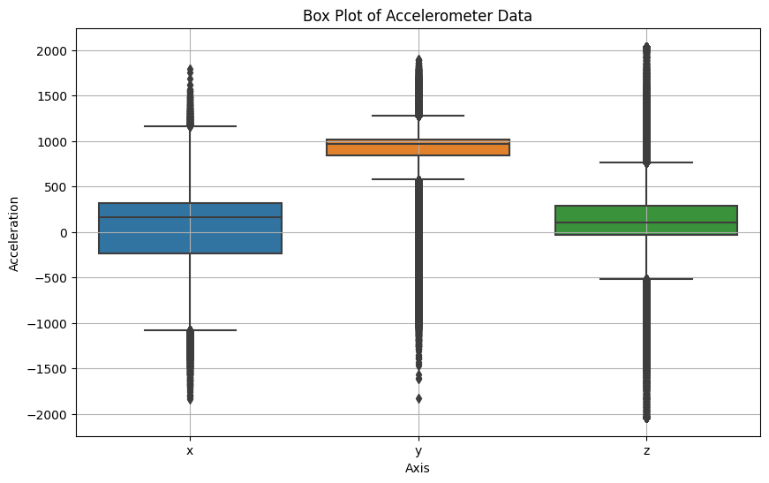
Data analysis
Performed various analysis measures to study the features
Boxplot
Result shows that majority of the data points are not along with central tendency whic shows data is not normally distributed.

Slide 9
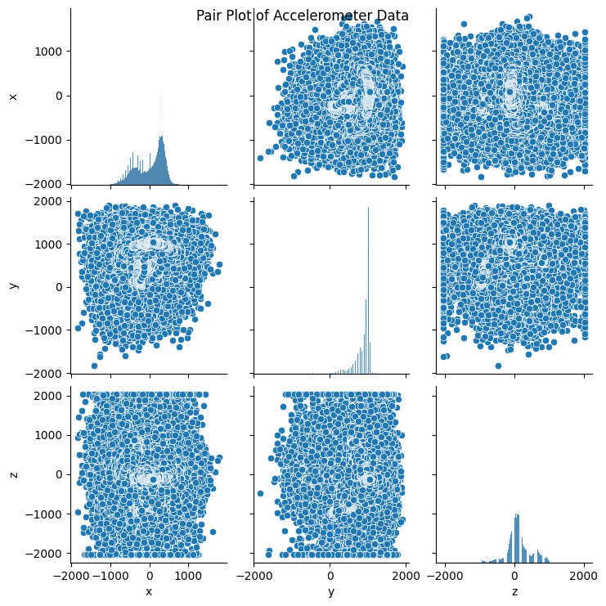
2. Pairplot
Its shows that features are not much related to each other

Slide 10
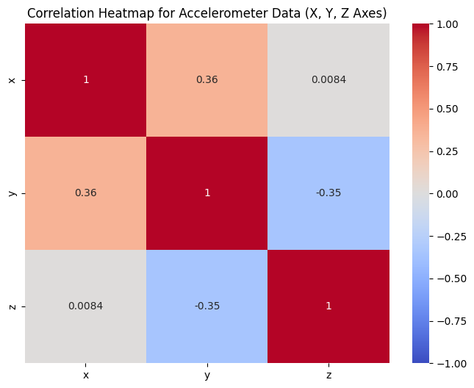
3. Heatmap

